Slide 1

The Emergence of Indirect or Direct Band Gap
Main Presentation
Yujie Liu and Siyu Liao
Oct. 29th, 2020

Slide 2
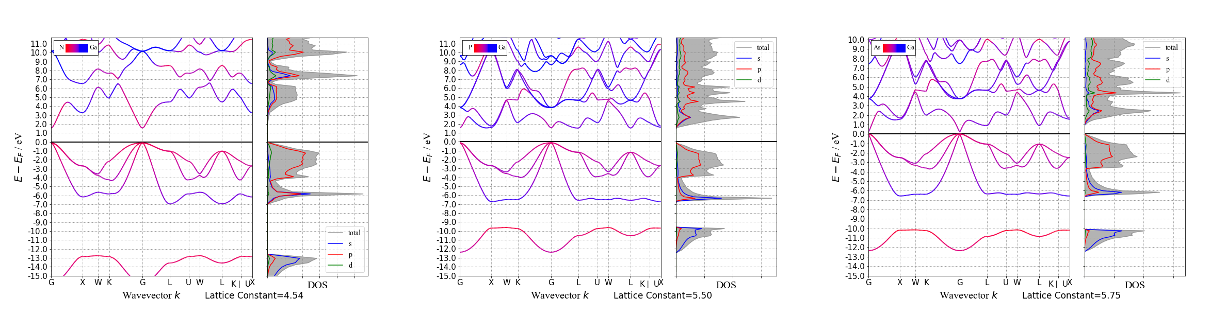
Background Knowledge
GaN
GaP
GaAs
Notes:
There should be a video here as a hyperlink and as the first display.

Slide 3
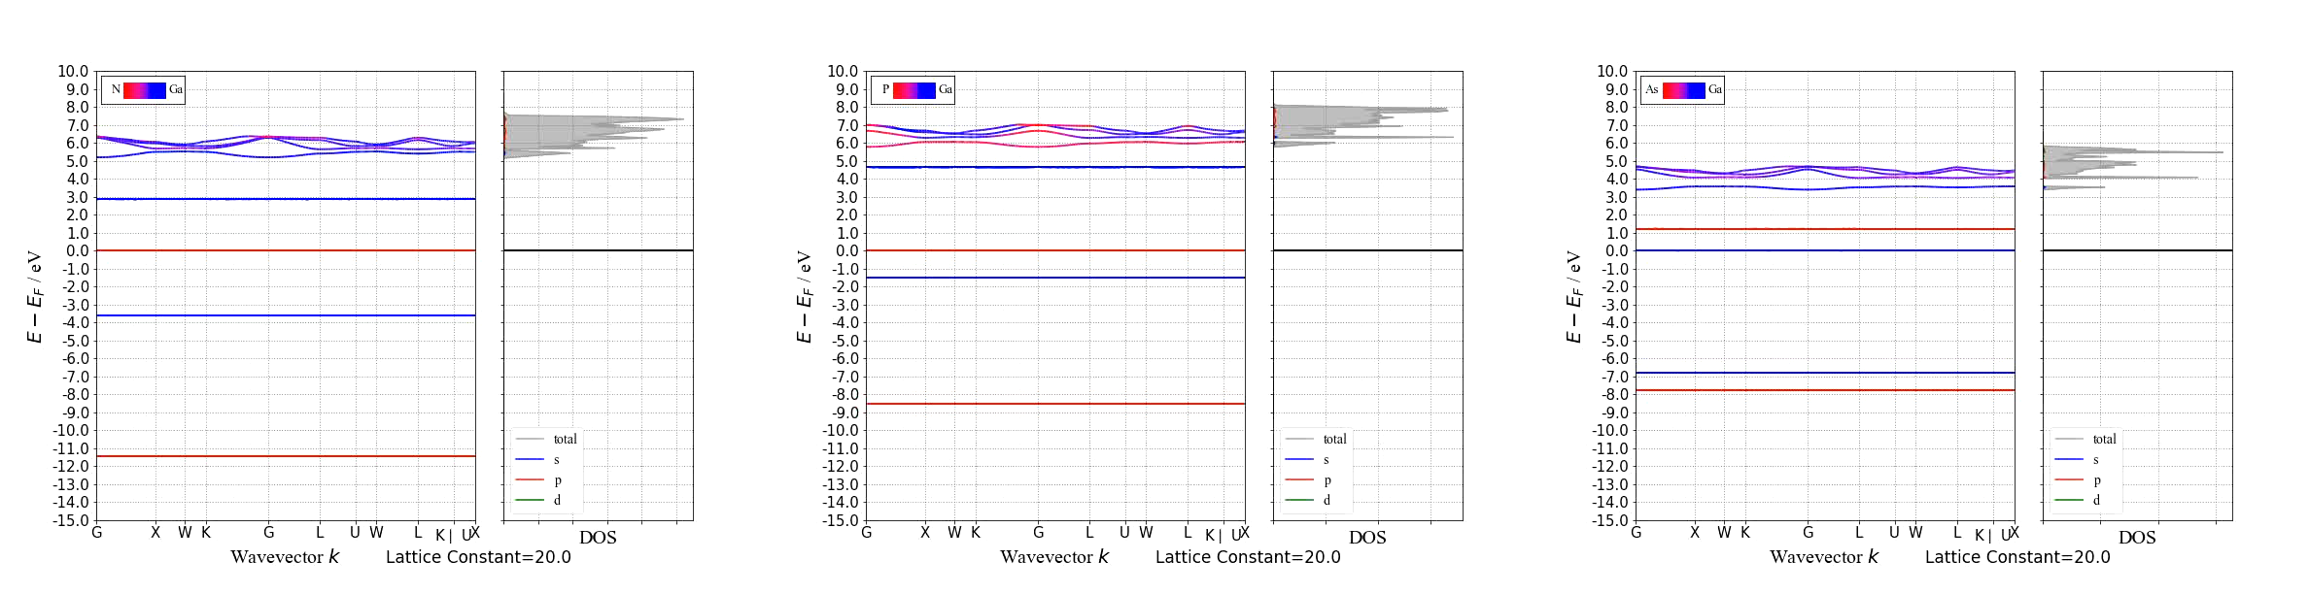
Background Knowledge
GaN
GaP
GaAs

Slide 4
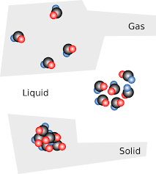
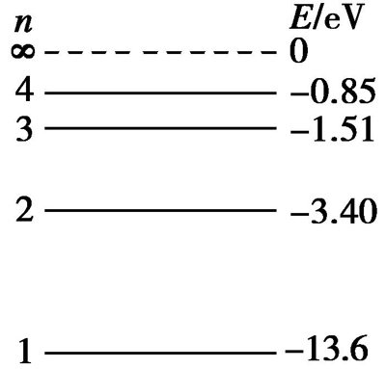
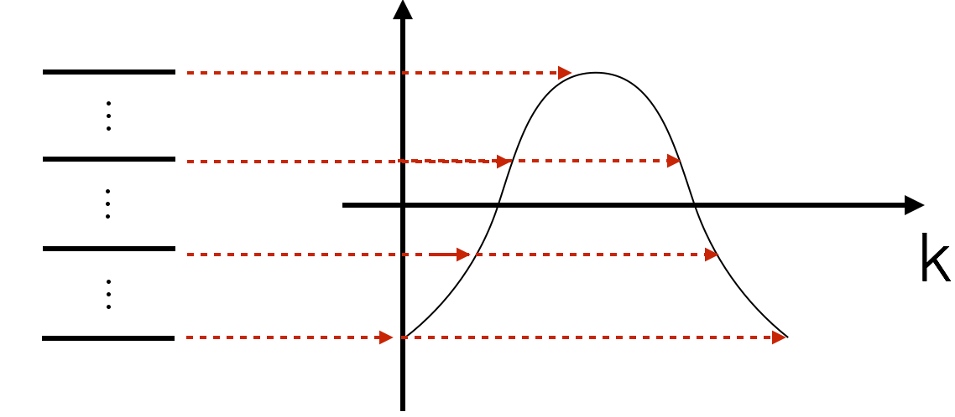
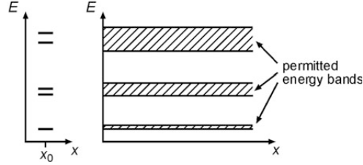
Background Knowledge
Quantitatively: Bloch theorem
What is the band structure? How does it form?
• the periodic structure of the crystal → periodic
potential approximation
• the single electron's Schrödinger equation with a
periodic potential
• the solution/eigenfunction
with (a space-dependent
amplitude factor which shows lattice periodicity)
• the wave vector : determined by periodic boundary
conditions → the allowable value
get closer → wave functions overlap → the original degenerate level splits into non-degenerate energy levels → allowed energy range
expand into a two-dimensional graph with k on the x axis
The band structure is the display of energy level in k-space (reciprocal space).
Notes:
Degeneracy is lifted, and the energy level is broadened to the energy band; two isolated atoms → one level, double degeneracy (without spin)
(the potential energy is disregard)

Slide 5
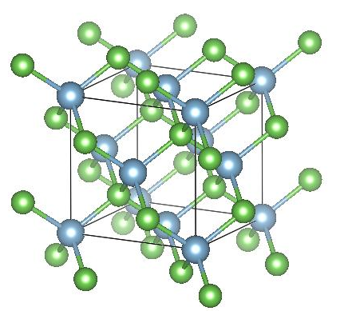
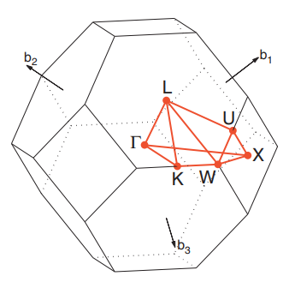
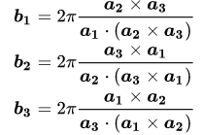
Background Knowledge
real space lattice VS reciprocal space lattice
(Brillouin zone, the primitive cell in k space)
The calculation of the band structures
• free electron (empty lattice) model → rough
• nearly free electron (weak lattice periodic potential)
model → energy gap at the Brillouin zone boundary
• tight-binding model → LCAO basis, the way to go
quantitatively
• real computation: self-consistent iterative calculation
→ DFT by VASP, also the density of states (DOS) and
Fermi surfaces, bonding strength (COHP), binding
energy …
AlAs: FCC (zinc blende), F-43m
How to “see” the emergence of the band structure?
Artificially bring the atoms closer and let the wave
functions overlap
from large cell to small cell, from "gas" to actual solid
vary the lattice constants without changing other things in the primitive cell
High symmetry points: E-k relations in different crystal orientations → complete description of the bands in the 1st Brillouin zone
Notes:
All Bloch wave energies are completely determined in this space, DOS is the number of microscopic states per unit energy interval near a certain energy

Slide 6
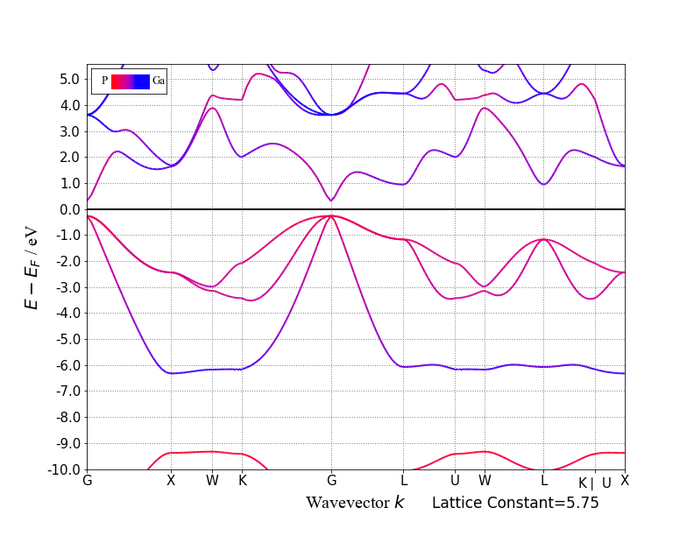
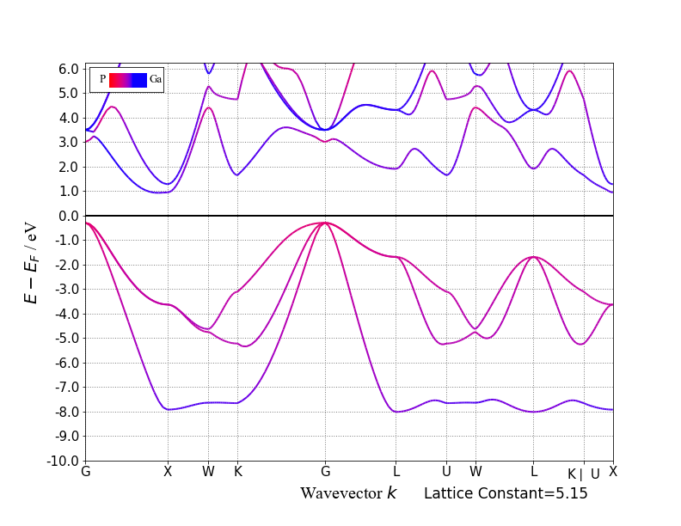
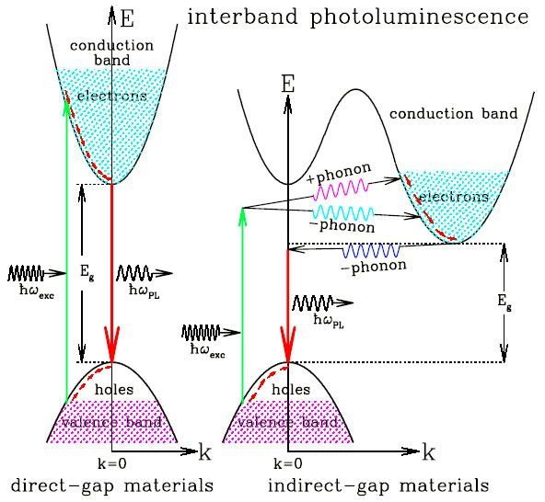
Research Content
Features in the band structure: direct/indirect band gap
Density of states (DOS)
• the number of states with energy between E~E+△E → use the E axis and the band structure to view
• orbital-projected version → see the main/individual orbital contribution
Notes:
Fermi energy lies in the energy band and satisfies the isoenergy surface set of Ef=En(k). In non-metals, the valence band is the highest range of electron energies in which electrons are normally present at absolute zero temperature, while the conduction band is the lowest range of vacant electronic states.
(convex hulls)

Slide 7
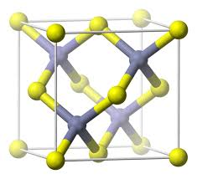
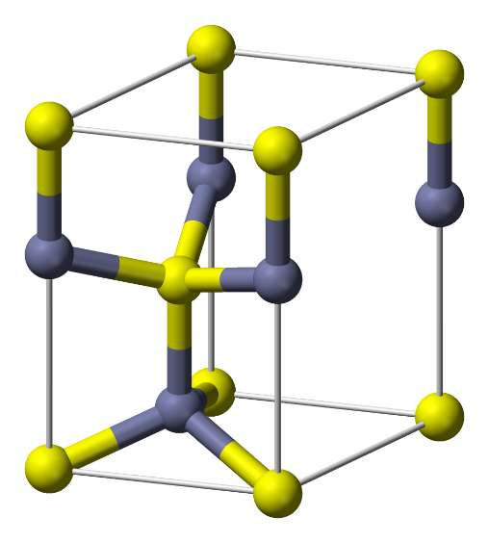
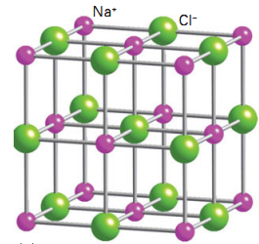
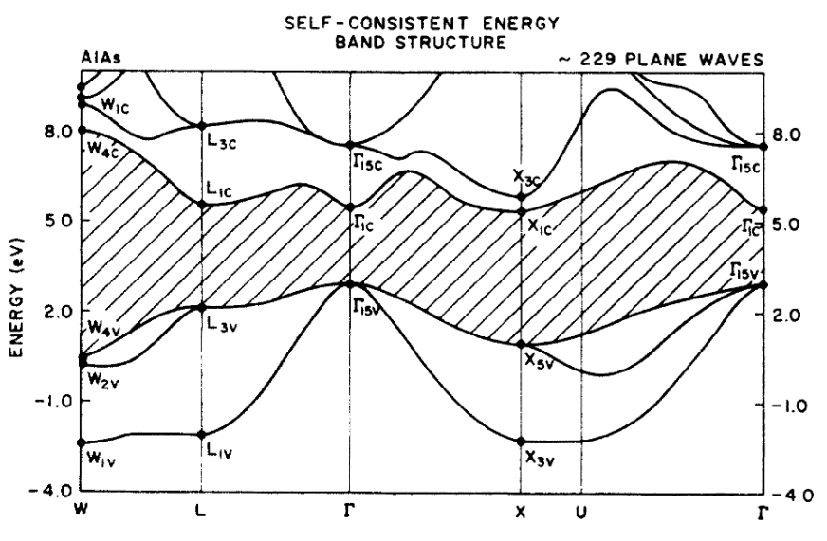
Research Content
Qualitative analysis of band structures
Why III-V semiconductors? → special features
• multiple simple crystal structures: zinc-
blende, wurtzite, rocksalt…
• indirect-direct band gap transition under
pressure/in different lattice constants at Γ (0,
0, 0), X (½, 0, ½)
• different chemical compositions within the
same group → easy for property research
and comparison
• The Γ point on the valence band appears
threefold degeneracy
Group theory: the degeneracy and the symmetry types of the electronic levels in the crystalline field → identify each band at high symmetry points
To analyze: from real space structure to reciprocal space energy bands

Slide 8
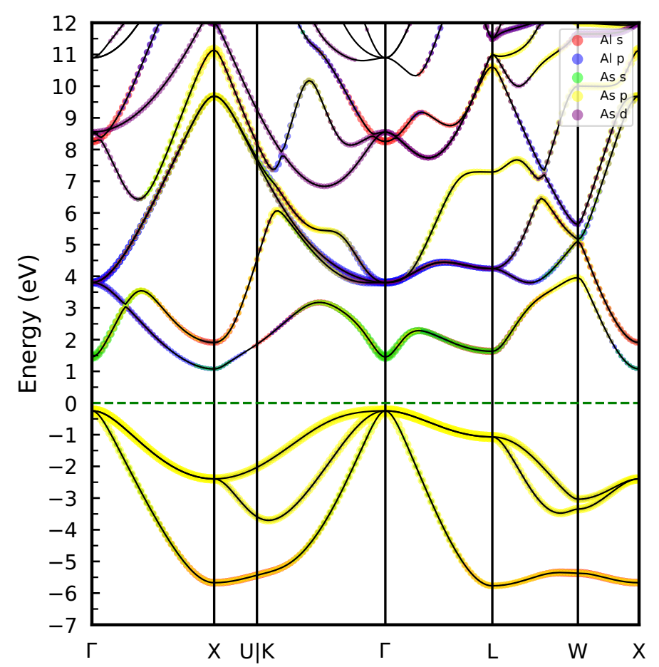
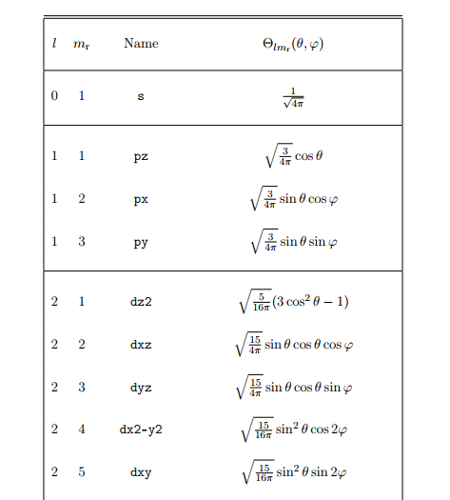
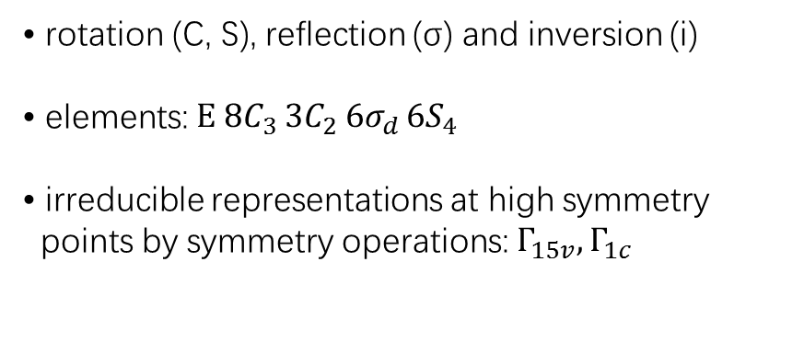
Research Content
Qualitative analysis of band structures: specific features above
• indirect-direct band gap transition under
pressure/in different lattice constants at Γ (0,
0, 0), X (½, 0, ½)
• The Γ point on the valence band appears
threefold degeneracy
Group theory related: symmetry operations
• rotation (C, S), reflection (σ) and inversion (i)
• elements: $E 8C_{3 }3C_{2} 6σ_{d }6S_{4}$
• irreducible representations at high symmetry
points by symmetry operations: $Γ_{15v}, Γ_{1c}$
Explanations
• p orbitals: three different wave functions →
threefold degeneracy
• Selection Rule: decide whether or not the states are indeed coupled through irreducible representations
Notes:
Every action that can restore a symmetrical image. Schoenflies notation, Plane wave expansion
when the irreducible representations of two bands are compatible (identical or one contain the other) could they couple with each other

Slide 9
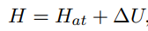
Research Content
Quantitative analysis of band structures: tight-binding related issues
Question: How to use some simple numbers to characterize the band structure?
Answer:
• LCAO (linear combination of atomic orbitals) based
wave functions√→ start point of tight-binding
approximation
• to get energy → Hamiltonian!
solve the bands ← solve the Hamiltonian ← a reasonable construction method (take care of the orbitals near the Fermi level)
→ Tight-binding model
Why tight-binding?
“tightly bound electrons in solids”
• describe the band structure over the entire Brillouin zone
• describes correctly band mixing
• gives atomic details
• low computational cost
• a real space approach
…
How to construct a proper Hamiltonian?

Slide 10
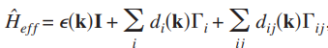
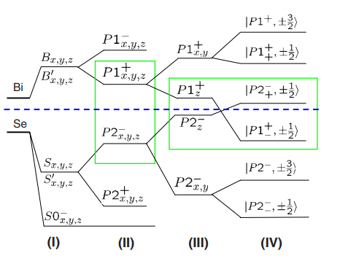
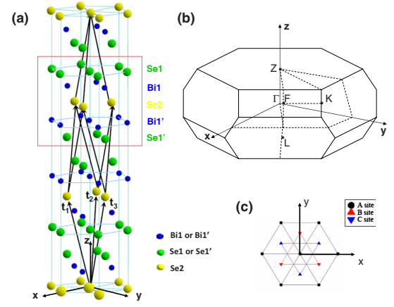
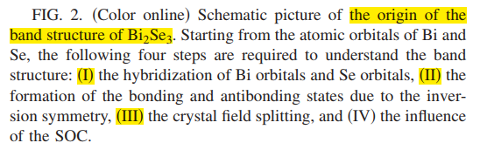
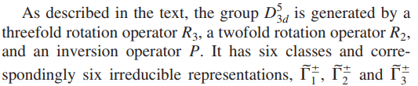
Literature research
Quantitative analysis of band structures: tight-binding related Hamiltonian derivation methods
1. Symmetry principle-based derivation
Liu, C. X., Qi, X. L., Zhang, H., Dai, X., Fang, Z., & Zhang, S. C. (2010). Model Hamiltonian for topological insulators. Physical Review B, 82(4), 045122.
Notes:
Any 4 by 4 matrix can be expanded with 15 4 by 4 Gamma matrices (plus an Identity matrix) as the basis vector

Slide 11
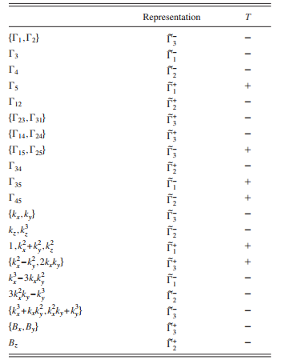
Literature research
Quantitative analysis of band structures: tight-binding related Hamiltonian derivation methods
1. Symmetry principle-based derivation
Method summary:
[1] electronic states →the basis of the Hamiltonian (four states);
[2] operators of symmetry operations of interest;
[3] all group representations of the double group (spin) at high symmetry points;
[4] Γ matrices and the corresponding group representations;
[5] Pair the Γ matrix with the polynomial of k in the same group → write the Hamiltonian.
basis functions of the irreducible representations
Bethe symbol
[Γ_i]•[k_j] → solve the Hamiltonian by its matrix elements
Liu, C. X., Qi, X. L., Zhang, H., Dai, X., Fang, Z., & Zhang, S. C. (2010). Model Hamiltonian for topological insulators. Physical Review B, 82(4), 045122.
Notes:
At Gamma point, each state should belong to an irreducible representation of the crystal symmetry group and the hybridization between orbitals preserve the symmetry properties.

Slide 12
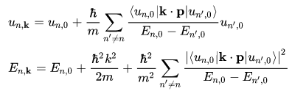
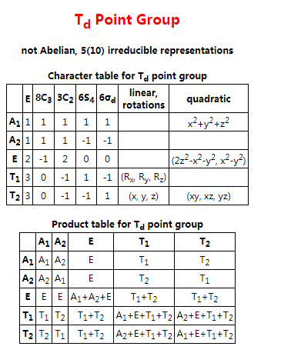
Literature research
Quantitative analysis of band structures: tight-binding related Hamiltonian derivation methods
2. k•p perturbation theory derivation
Example:
AlAs has the point space group Td
Advantage: randomly choose the proper basis functions
• the same H as the symmetry principle-
based derivation
• some fixed models: 8-bands, 4-bands model,…
• parameters fitted → linked to DFT results, the
wannier functions, the tight-binding, …
That’s enough!
Liu, C. X., Qi, X. L., Zhang, H., Dai, X., Fang, Z., & Zhang, S. C. (2010). Model Hamiltonian for topological insulators. Physical Review B, 82(4), 045122.

Slide 13
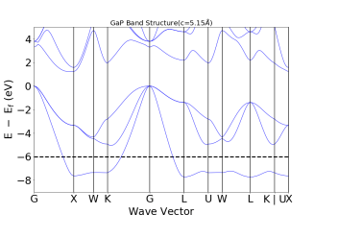
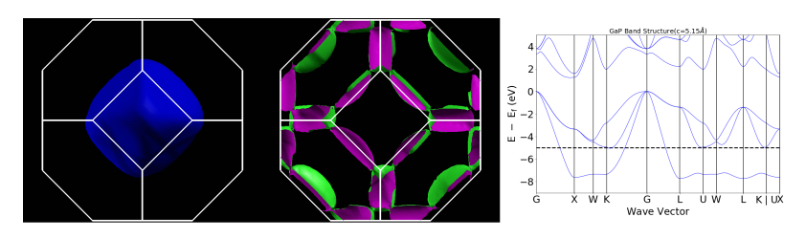
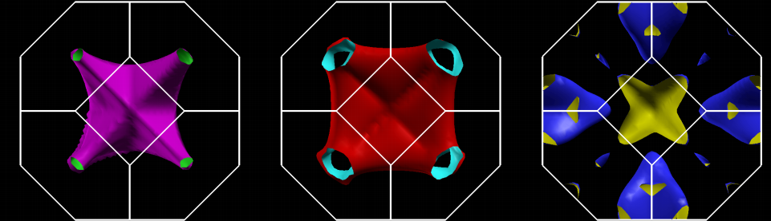
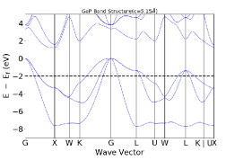
Fermi surfaces
Definition:
the isoenergy surface with the highest occupied energy level;
the interface between the occupied states and the non-occupied states when T=0.
3D: the surface with energy E_F in k-space
Fermi surfaces of zinc blende GaP, tune the E_F to cross band 8, 9 and 10
With the variation of Fermi level/lattice constants → “Fermi surfaces” change
Notes:
Generally speaking, semiconductors and insulators do not use Fermi surface but use the concept of valence band top.

Slide 14
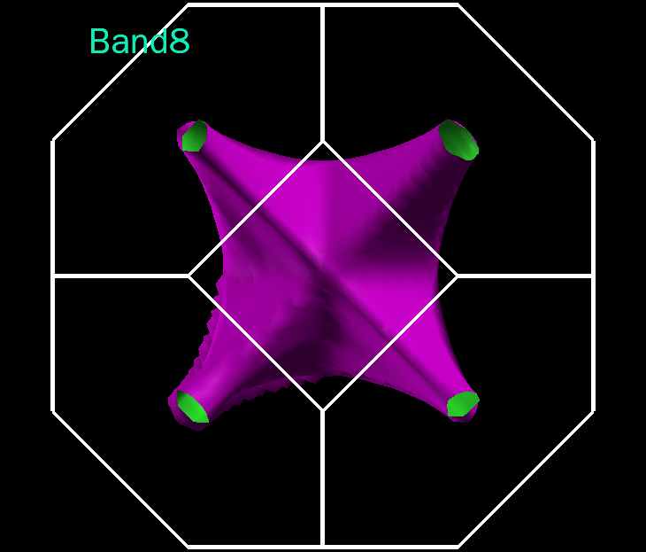
Fermi surfaces
Fermi surfaces’ variations

Slide 15
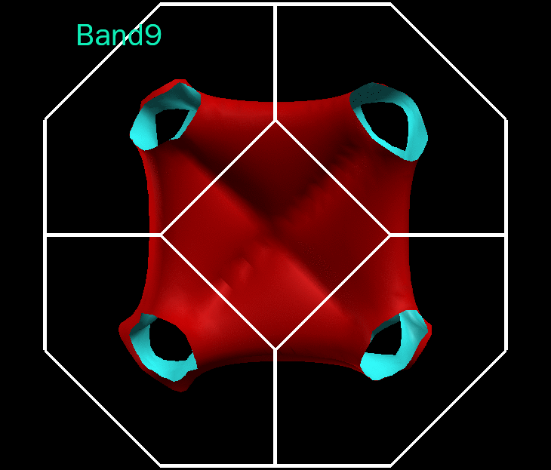
Fermi surfaces
Fermi surfaces’ variations

Slide 16
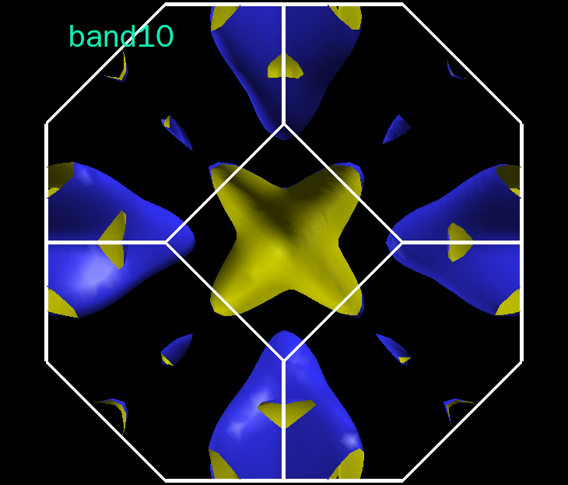
Fermi surfaces
Fermi surfaces’ variations

Slide 17
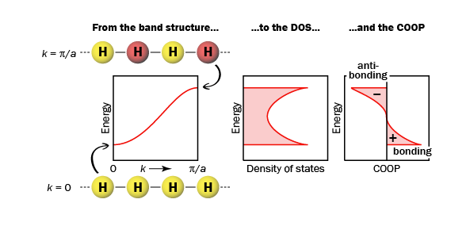
COOP
COOP (Crystal Orbital Overlap Population)
• A method to show bonding information between orbitals
It can be easily understood by multiplying the DOS by the overlap population.

Slide 18
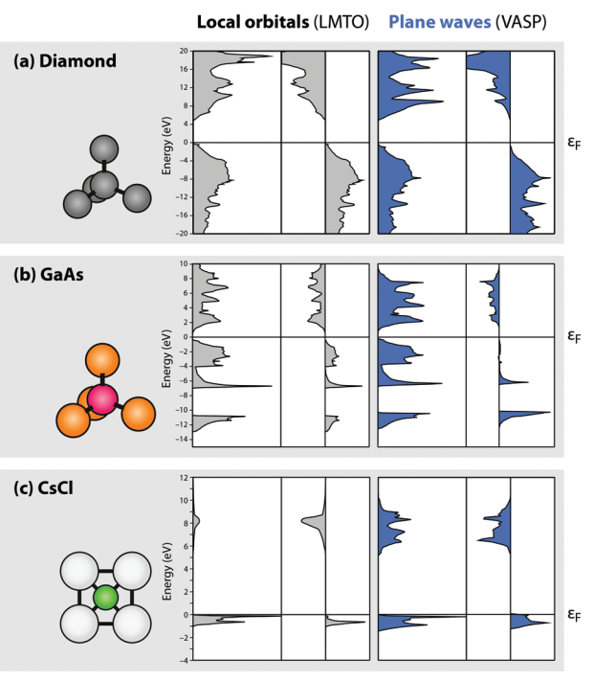
pCOHP
pCOHP (Projected Crystal Orbital Hamilton Population)
• COHP is weighted by the elements of the Hamiltonian matrix while COOP is weighted by the elements of the overlap matrix.
• pCOHP is powerful when we care for the couplings between specific orbitals.
Deringer, V. L., Tchougréeff, A. L., & Dronskowski, R. (2011). Crystal orbital Hamilton population (COHP) analysis as projected from plane-wave basis sets. The journal of physical chemistry A, 115(21), 5461-5466.

Slide 19
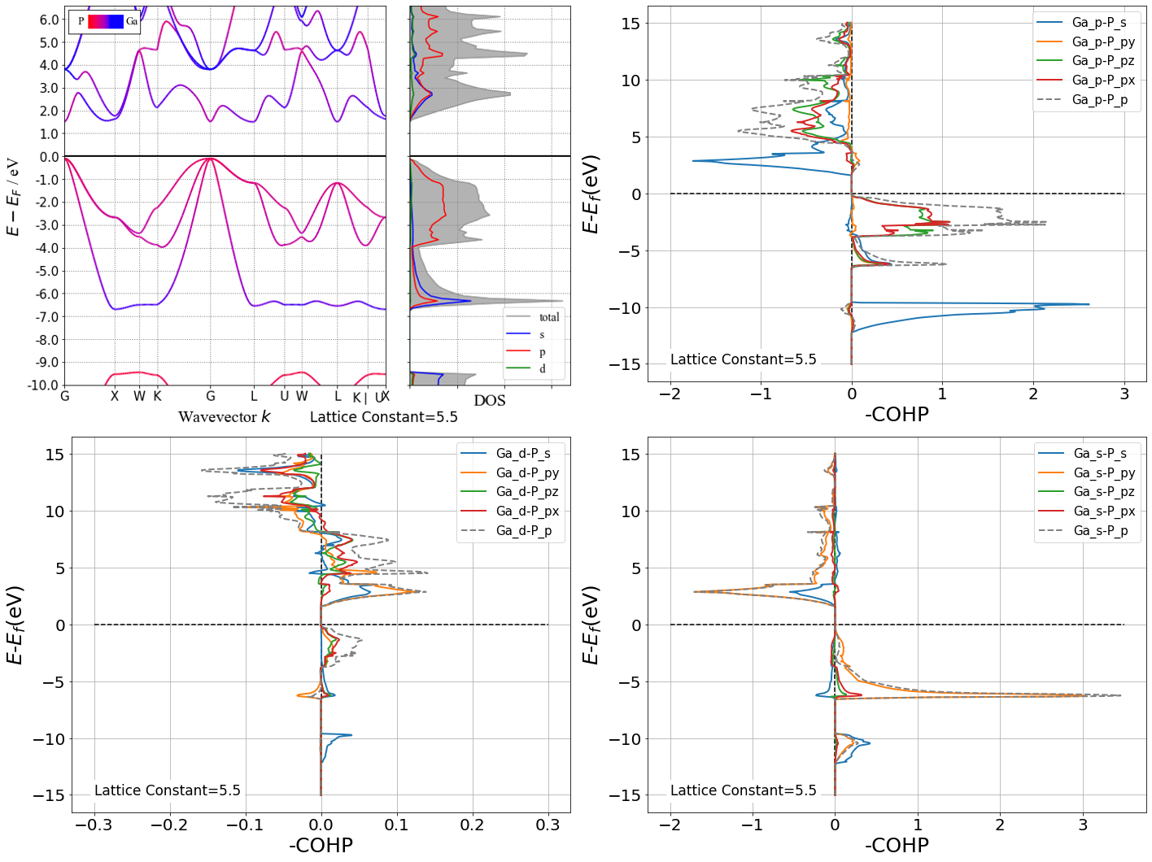
Research Content
GaP’s band structure and DOS
Ga-p orbitals’ pCOHP
Ga-d orbitals’ pCOHP, which is about 10 times weaker than Ga-s and Ga-p orbitals.
Ga-s orbitals’ pCOHP
Notes:
COHP analysis is powerful in analyzing the bonding information in complex system. In this system we need more delicate tools to illustrate which bands couples at which places, so we introduce group theory.

Slide 20
Research Content
Qualitative analysis of band structures: conclusion
Band Structure
Crystal Structure
Space Group
Lattice Constant
Chemical Property
Valence Electrons

Slide 21
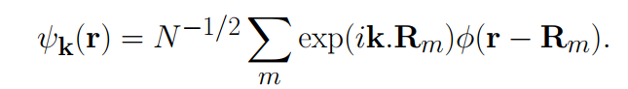
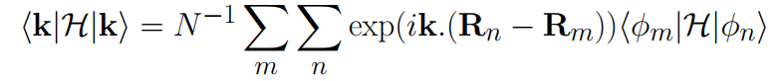

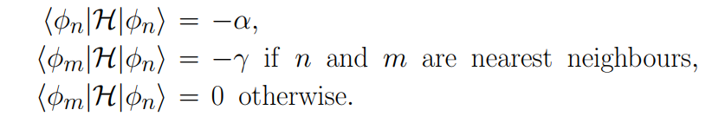
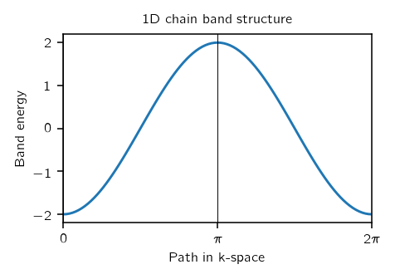
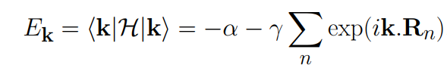
Tight Binding Theory
An initial assumption of tight binding model is regarding single electron wave functions in crystal as a linear combination of atomic orbitals (LCAO).
To get the band structure, we just need to find the expectation energy of the Hamiltonian
When only considering up to the nearest neighbor atoms:
We have:

Slide 22
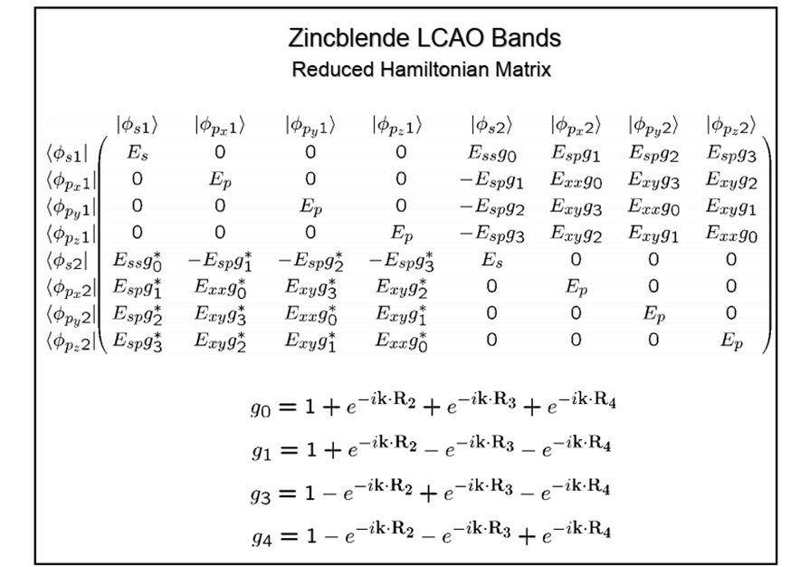

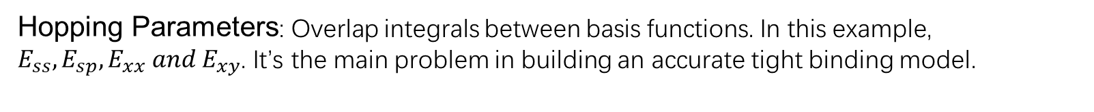
Tight-binding model
Basis Functions
Onsite Energy
Hopping Parameters: Overlap integrals between basis functions. In this example, $E_{ss}, E_{sp}, E_{xx} and E_{xy}$. It’s the main problem in building an accurate tight binding model.

Slide 23
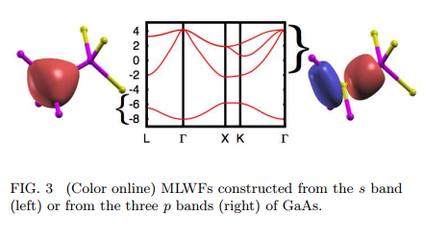
Wannier Functions
Maximally localized Wannier functions (MLWF)
Bloch function:
Fourier transformation
Wannier function:
Wannier functions and Bloch functions describe the same thing in different representations. Bloch functions take K representation in reciprocal space while Wannier function take R representation in real space.
Benefits:
• localized in real space
• Wannier90 package can easily generate an accurate tight binding model from DFT results.
Marzari, N., Mostofi, A. A., Yates, J. R., Souza, I., & Vanderbilt, D. Maximally localized Wannier functions: Theory and applications. Reviews of Modern Physics, 84, 1419 (2012).
Notes:
The more delocalized the k space, the more localized the real space

Slide 24
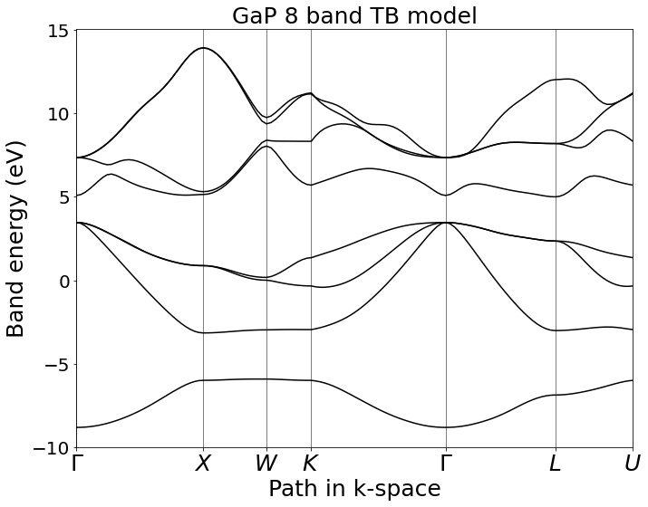
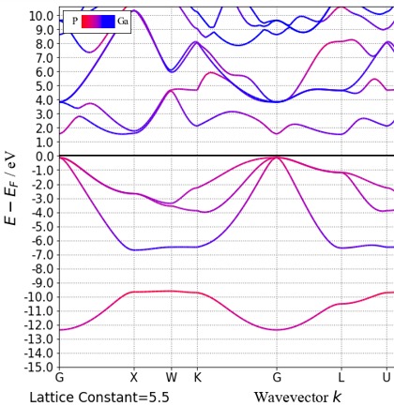
Tight-binding model
Workflow:
Regular Vasp self-consistent calculation
Wannier90 calculation
PythTB
To generate input files for Wannier90
To get tight binding model
Visualization and Analysis
VASP band structure
Notes:
Left is GaP’s tight binding band structure by virtue of Wannier90 and PythTB when considering only s and p orbitals . They contain total 13532 hopping parameters.

Slide 25
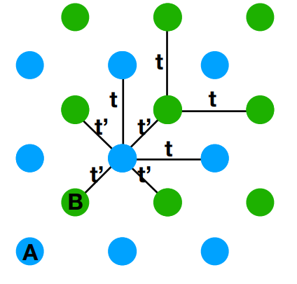
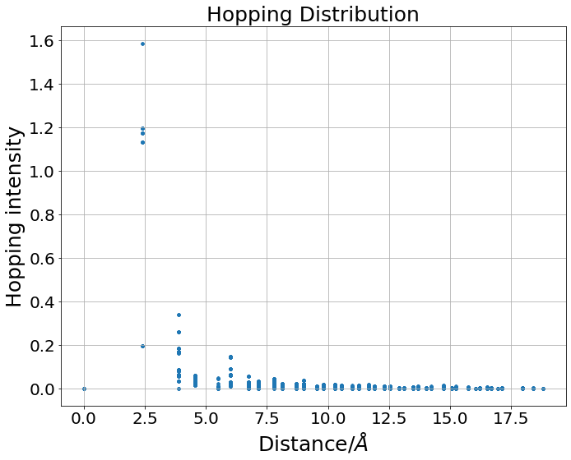

Visualization
Tight-binding model
Taking logarithm on hopping intensity
Nearest neighbor atoms
Atoms from five conventional cells away
13532 hopping parameters in all

Slide 26

Tight-binding model
Least hopping intensity = 0.01
Logarithm base e
denary logarithm

Slide 27

Tight-binding model
Least hopping intensity = 0.01
Least hopping intensity = 1.19
Since there are too many hoppings to reach a high accuracy, I gradually increase the threshold of hoppings that appear in TB in order to grep main features. The left picture is energies of four crucial high symmetry points with the change of numbers of hoppings.
Notes:
Their positions are illustrated on the right side.

Slide 28

Tight-binding model

Slide 29

Tight-binding model
The trend of band gap remains a lot of features to explore.

Slide 30

Future work
Extracting numerical features from Wannier90 tight binding model and combing those features with machine learning for application.
Utilizing the workflow in other systems like $GeO_{2}$ or some topological insulators for the construction of efficient Hamiltonian.

Slide 31
Thanks for watching!

